Slide 1
Page | 1

Slide 2
MedicOnLine
How To Add MOL To Home Screen On Your Mobile:
Follow the next few slides…
Page | 2

Slide 3
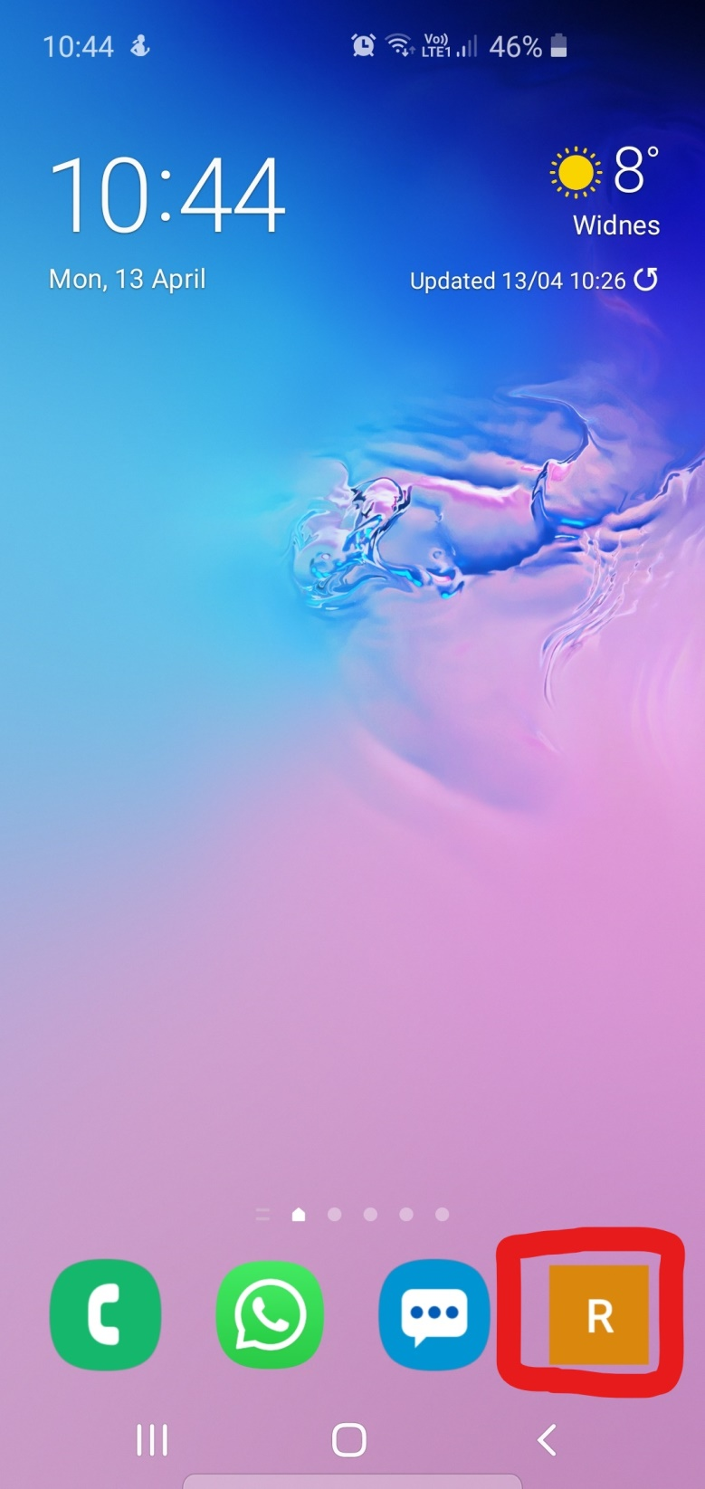
1. Select your emails (this could be an app) on your mobile device.
Page | 3

Slide 4
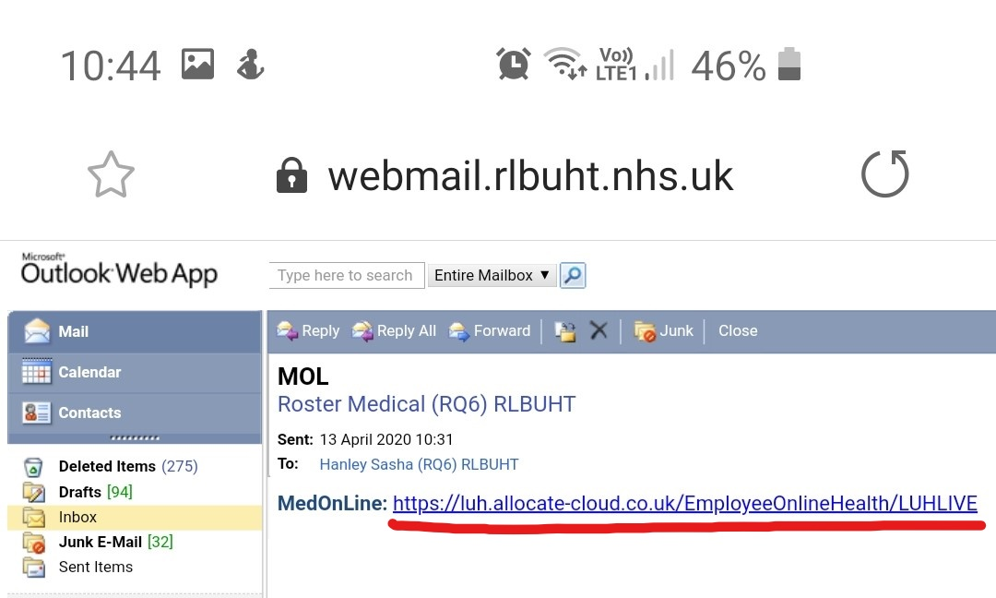
2. Click on the MediOnLine link
Page | 4

Slide 5
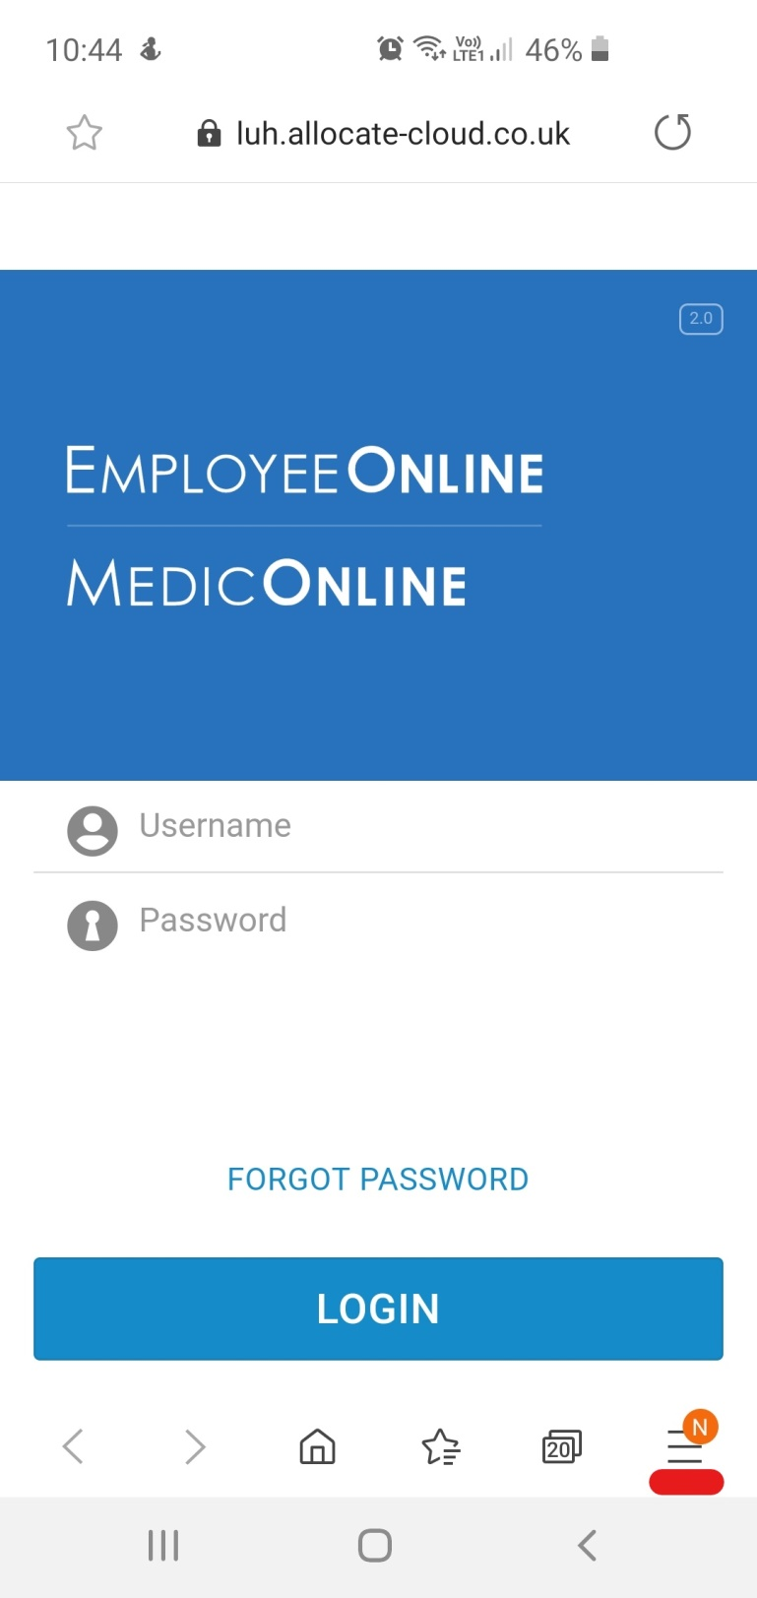
3. MedicOnLine will open in Internet Explorer.
4. Click on the 3 lines in the corner
Page | 5

Slide 6
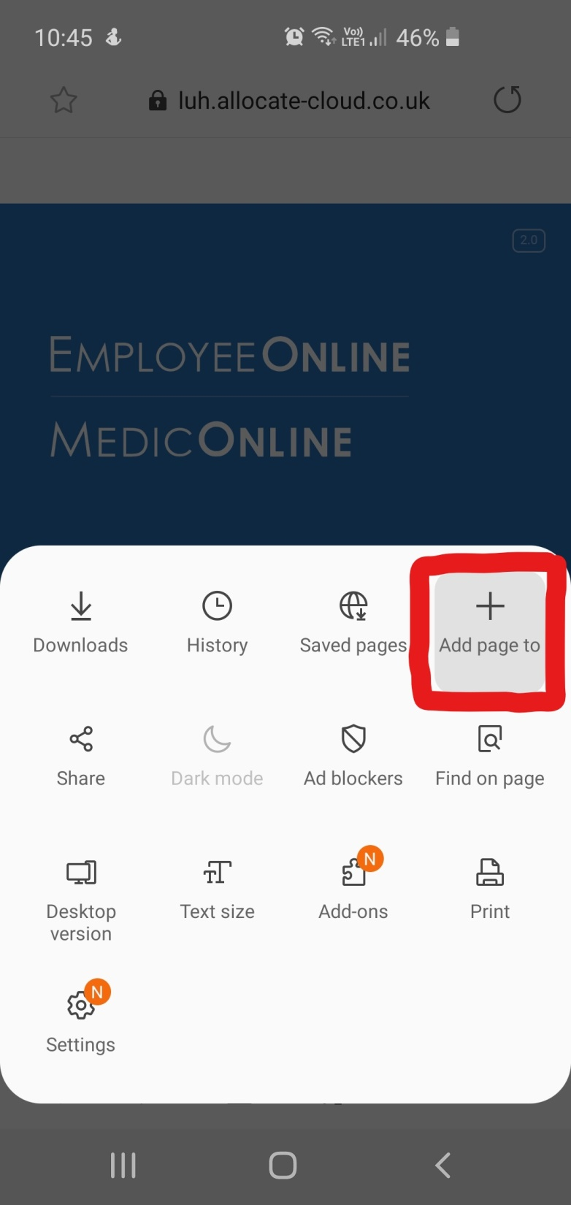
5. Click on ‘Add page to’
Page | 6

Slide 7
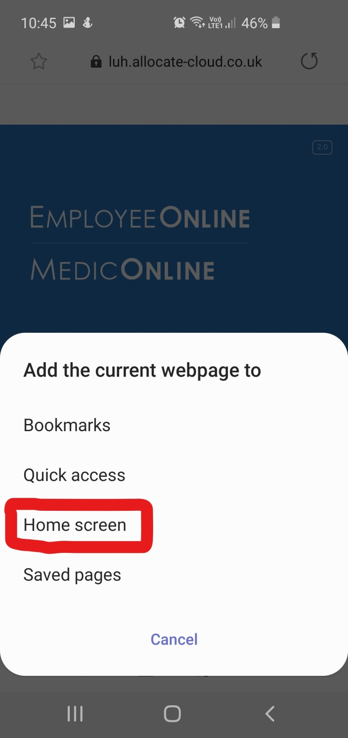
6. Click on ‘Home Screen’.
*(You can add the link to anything else you require – Create it as a bookmark (this is just personal preference)*
Page | 7

Slide 8
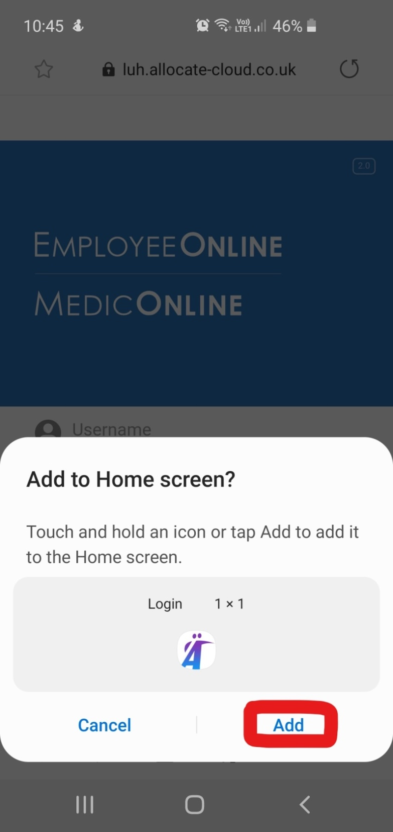
7. Click on ‘Add’ or hold down the icon
Page | 8

Slide 9
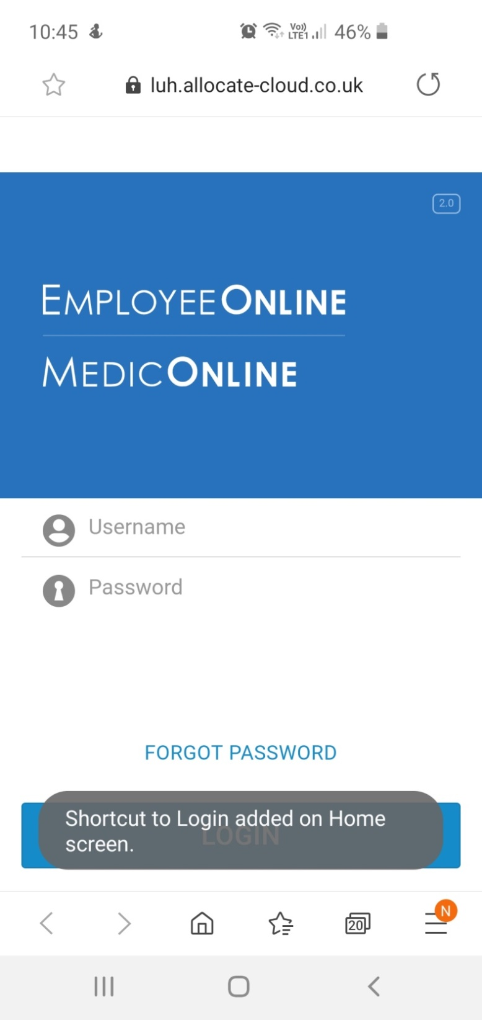
9. A Message will appear for a few seconds to say that your shortcut to MedicOnLine has been added to your home screen.
Page | 9

Slide 10
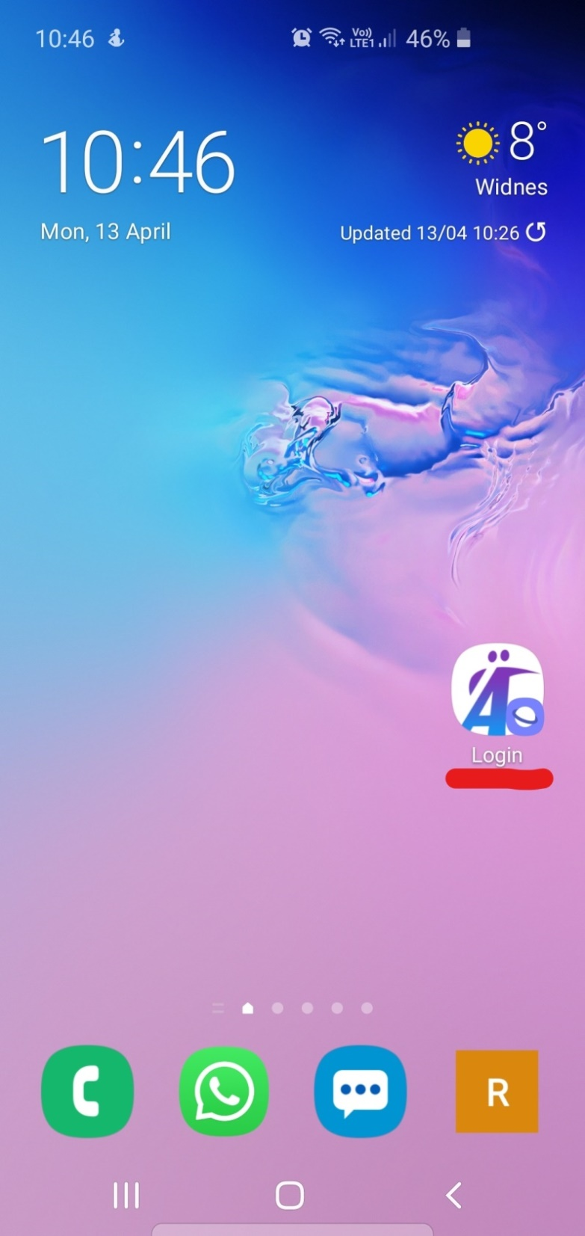
10. MedicOnLine app is now available for you to use (Just 1 click away)
Once the shortcut has been added to your home screen you do not need to do this every time you want to log in.
Page | 10

Slide 11
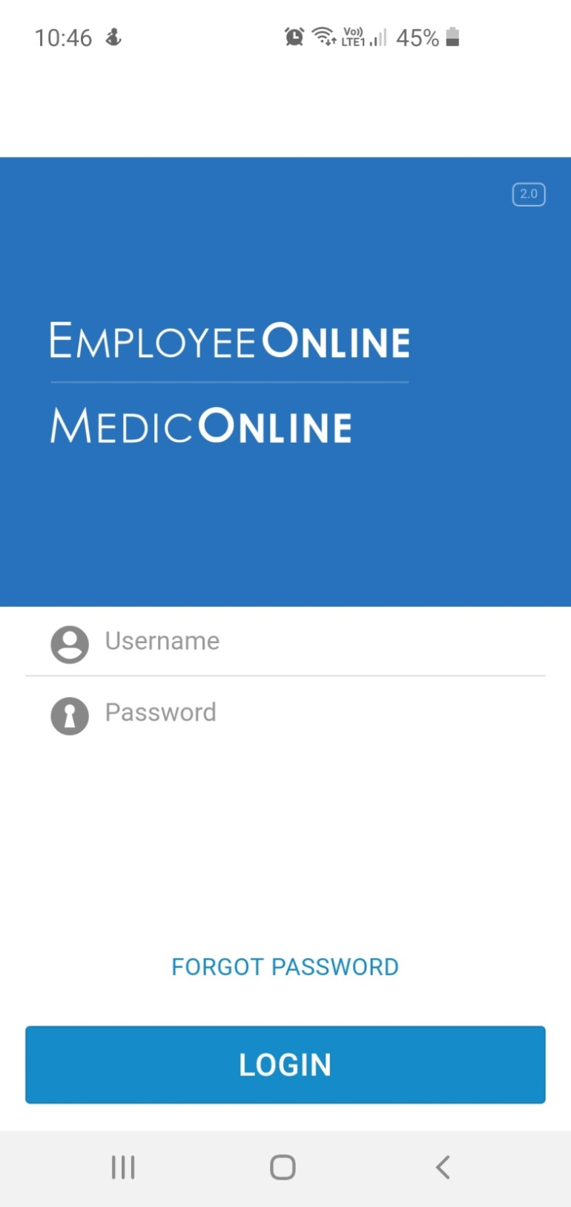
11. Now you can log in with your username and password.
If you are having trouble logging in or have forgotten your password, please email us on:
Medical.Roster@liverpoolft.nhs.uk
Page | 11

