Slide 1
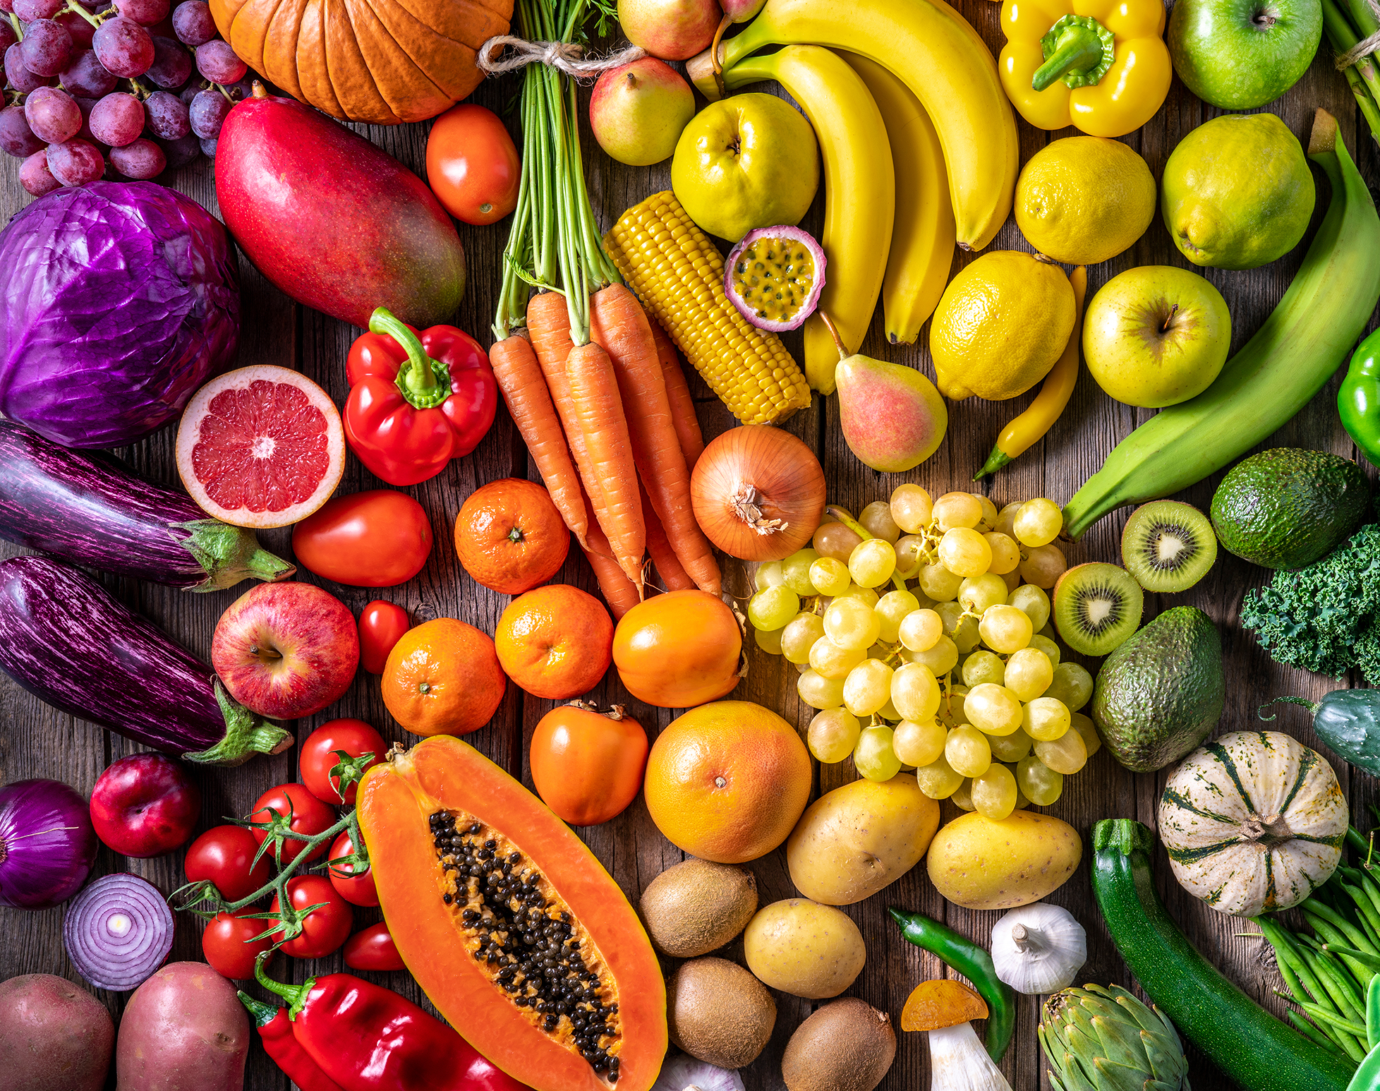
Menopause & diet
Niamh Cassidy
B5 Weight Management Dietitian
Michaela James
Principal Dietitian

Slide 2
Outcomes
Effects of menopause
Menopause and dietary impact – weight gain, bone health, heart health, hot flushes.
Importance of sleep
Questions
Useful resources

Slide 3
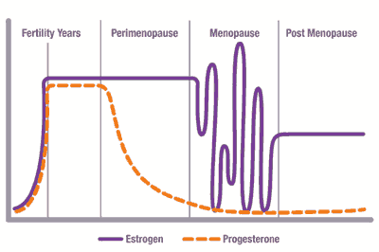
Effects of Menopause
A reduction in oestrogen can lead to:
Weight gain (especially abdominal)
Increased level of bloods fats
Changes in carbohydrate metabolism – increased insulin resistance
Reduced bone density
Hot flushes
Sleep difficulties
Mood changes

Slide 4
How can diet & lifestyle changes help?

Slide 5
Weight Gain
Most people gain weight with age as our basal metabolic rate slows.
Furthermore, lowered oestrogen is associated with loss of LBM and increase in FM.
Fat cells produce a weaker form of oestrogen naturally, therefore, the body tries to compensate with this.
Increased abdominal fat
Can lead to insulin resistance - body produces more insulin and insulin is associated with fat storage.

Slide 6
Bone Health
Related to lower levels of oestrogen and calcium consumption during pregnancies.
Oestrogen help prevent break down of bones.

Slide 7
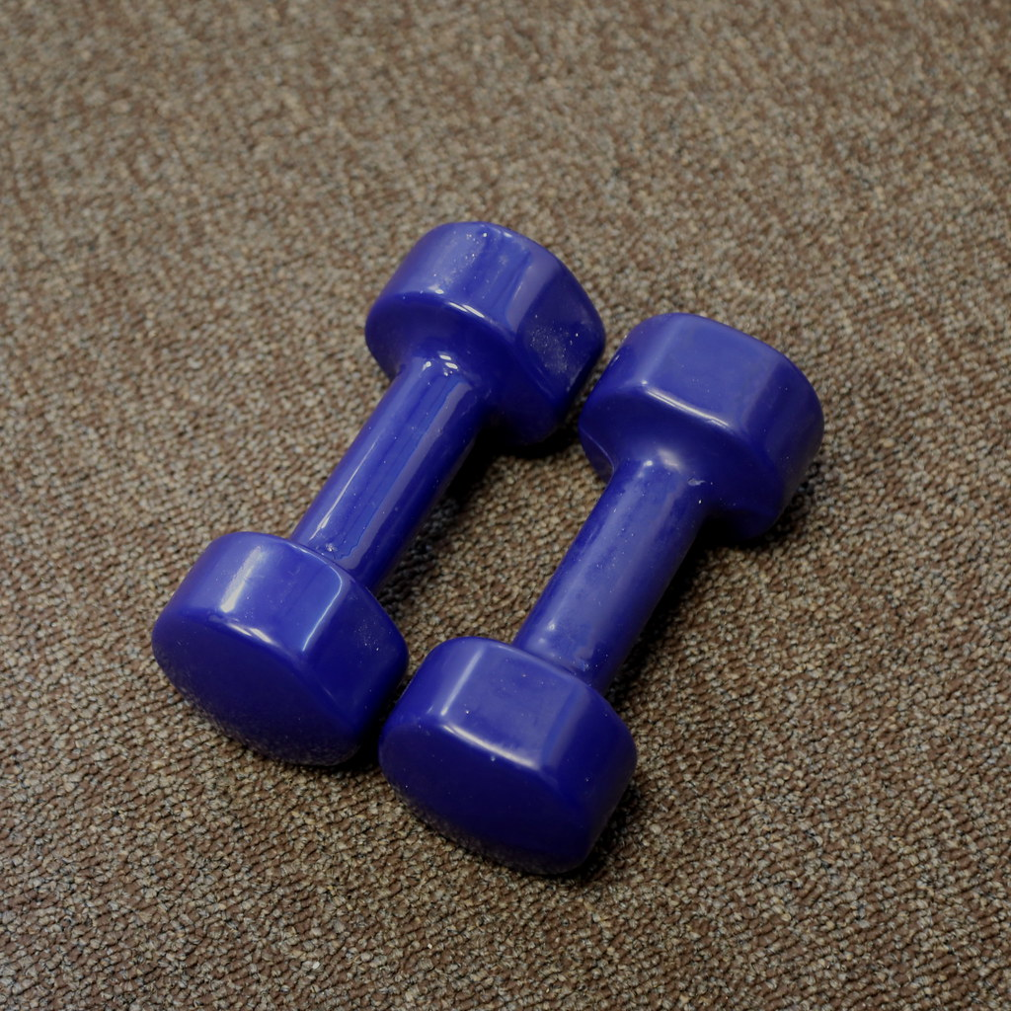
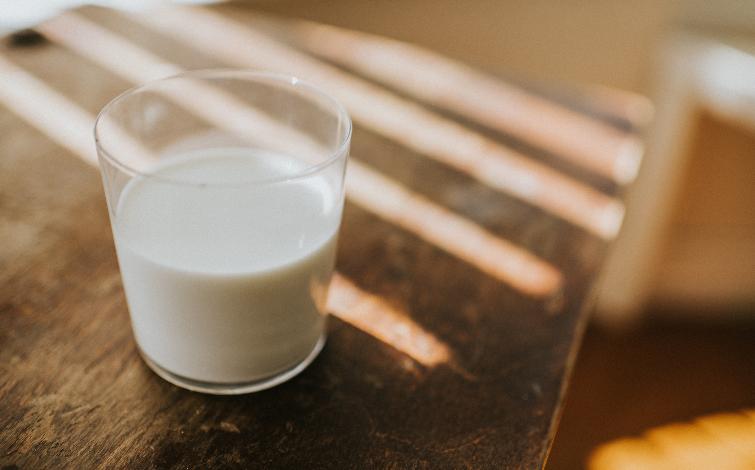
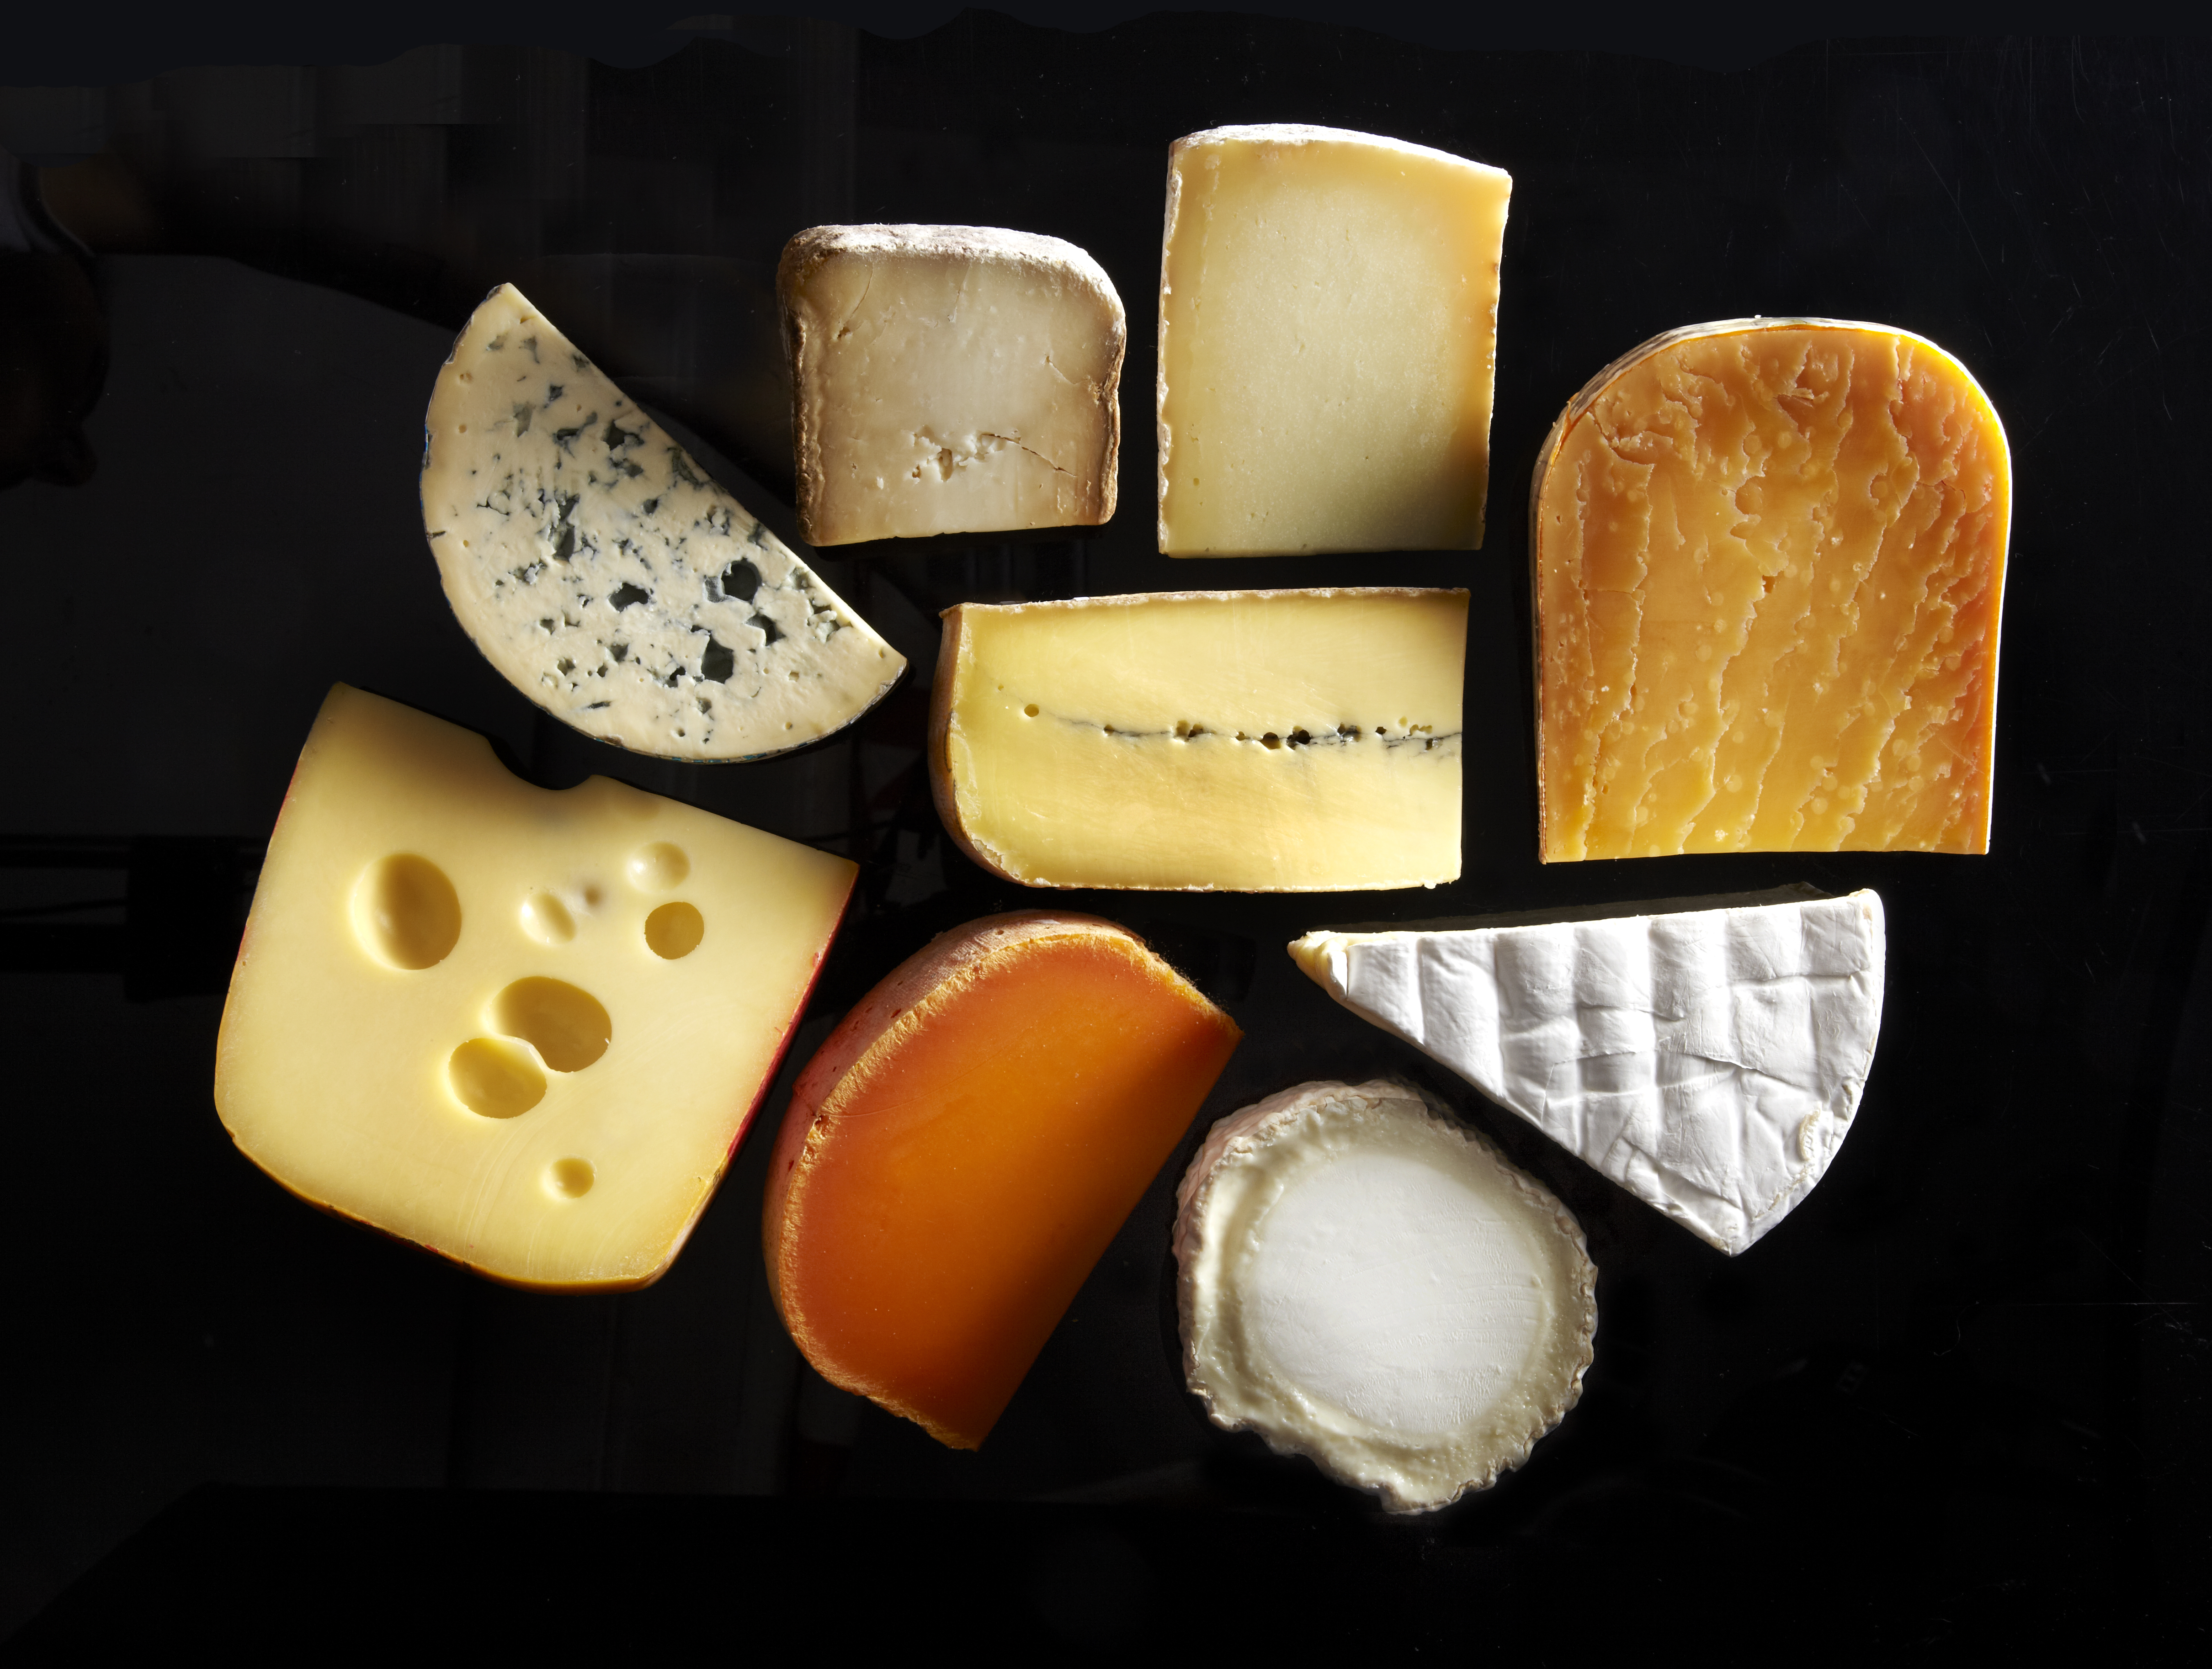
Bone Health
Aim 2-3 portions of calcium rich foods /d
Take a vitamin D supplement-10µg/d especially in winter
Aim 20-25g protein /meal
Weight bearing exercise

Slide 8
Heart Health
How to help:
Mediterranean diet
Activity
Stress management
Sleep

Slide 9
Hot Flushes
If hot flushes are troublesome you may wish to look at reducing caffeine and alcohol
Try phytoestrogens (plant compounds with oestrogen-like properties)

Slide 10
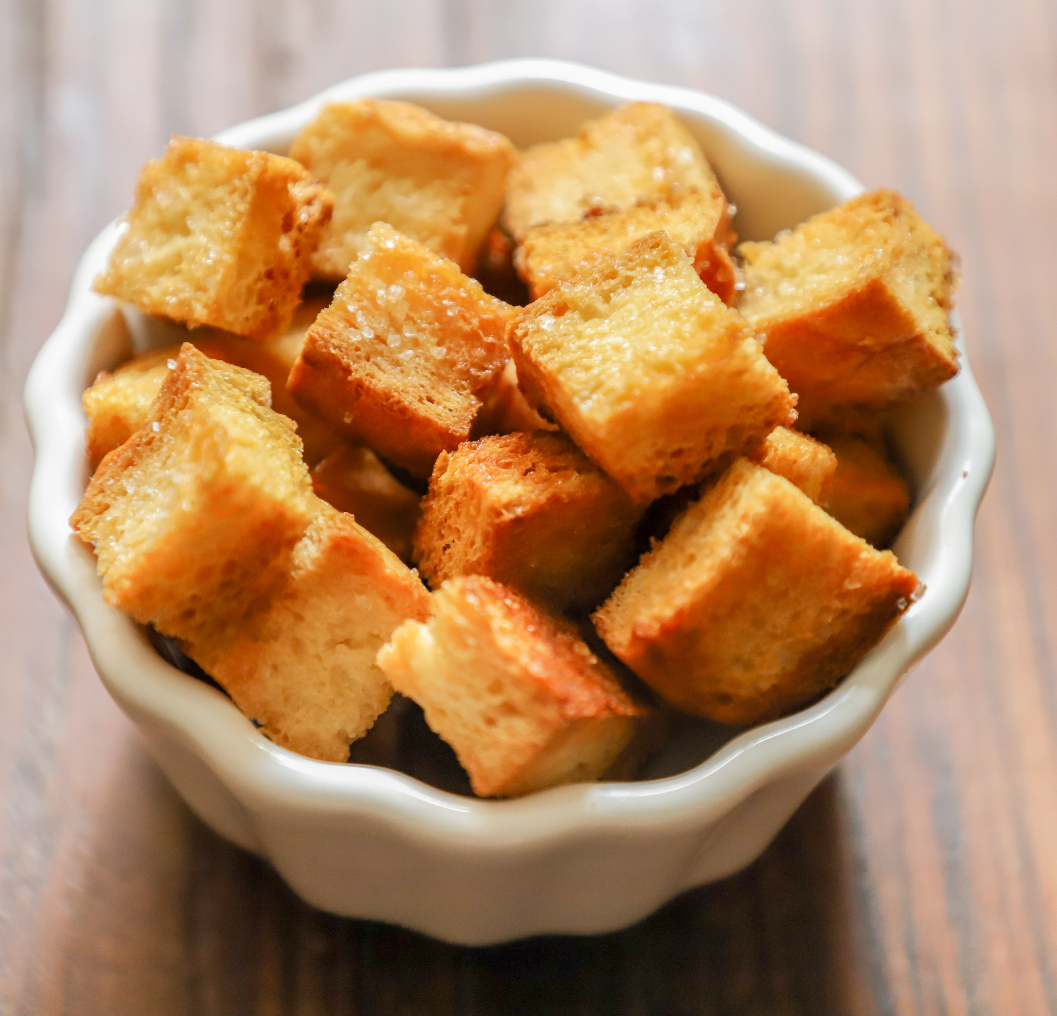
Phytoestrogens
Phytoestrogen is plant derived xenoestrogen that has been found to be beneficial in combatting oestrogen deficiencies.
It can take 2-3 months to see the benefits of including 2 servings in your diet daily.
Isoflavones – soybeans
Ligans – flaxseeds, wholegrains, fruit and vegetables, legumes

Slide 11
Sleep difficulties

Slide 12
Sleep difficulties
Hormones involved
Sleep Issues
Oestrogen
Progesterone
Cortisol
Melatonin
Takes longer to get to sleep
Reduced REM sleep
Less time asleep
Disturbed sleep (anxiety/ hot flushes/ restless legs)
(all affected by menopause)

Slide 13
Tips to help improve sleep in menopause
Keep room on cooler side (~18C)
Try multiple layers of covers so can add/remove as needed
Use natural fibres (cotton/linen) for nightwear
Cut back /avoid caffeine and alcohol
Try avoiding spicey foods before bed (may help some women)
Limit screen time in evening
Keep to regular bedtime routine
Exercise regularly but not too close to bedtime

Slide 14
Questions
1. How/when we are going through menopause are we to lose weight? Although I’m not eating a lot, I seem to be putting on weight so easily. Do I need to have specifically allocated food that work with one another in order to ensure weight loss? Are there any foods that I need to specially avoid which will help this?
(Energy in) - (energy out) = calorie deficit
Calculate a 2–3-day average intake, with no restriction, then take away 400-500kcal
Certain foods to avoid in terms of weight loss are of course saturated fats e.g., cream, butter, pastries, chocolates etc as well as free sugars which are found in sweets, biscuits, fizzy drinks, and of course standard sugar you add to your cuppa.

Slide 15
Questions
2. What vitamins / food would be advised as hormone levels change?
Phytoestrogens sources
Soybeans and soya-based foods
Chickpeas
Flaxseeds
Sesame seeds
Peanuts
Barley
Berries
Apricots
Grapes
Garlic
Tea (both green and black version)
Bone Health
Calcium (700mg/d) sources – dairy foods, tinned sardines, fortified plant drinks
Protein
Vitamin D (10µg/d) egg yolk, oily fish, fortified foods
Vitamin K (1µg/kg body weight) - turnip, broccoli, spinach, kale, dairy, meat, chicken
Phosphorous (550mg/d) - red meat, dairy, bread, oats
Magnesium (270mg/d)– seeds, wholegrains, almonds and beans
Heart Health
Saturated fat -> Unsaturated
Wholegrains
5-a-day at least
2 portions of fish/week, or else Omega-3 supplementation
4 portions of unsalted nuts, seeds and legumes each week
Limit salt and sugar
Limit alcohol to 14units throughout the week
Limit stress

Slide 16
Questions
For a throat that is sometimes a bit drier... what would be advised?
Are there any foods to target to help or ones to avoid that will hinder feeling clear headed or for joint pain.

Slide 17
Questions
Any patterns for eating to avoid in order to promote good sleep.
Any foods that are good for mood swings and anxiety? I avoid caffeine and sugary food but is there anything I should eat more of that will help with mood fluctuations

Slide 18
Links
https://www.bda.uk.com/resource/menopause-diet.html
https://www.themenopausedietitian.co.uk/
Diet & Menopause - The Food Medic
https://www.sleepstation.org.uk/articles/health/menopause-and-sleep/
Full article: Understanding weight gain at menopause (tandfonline.com)

Slide 19
Thank you for listening!

